Slide 1
Chapter 5: CPU Scheduling

Slide 2
Chapter 5: CPU Scheduling
Basic Concepts
Scheduling Criteria
Scheduling Algorithms
Thread Scheduling
Multi-Processor Scheduling
Real-Time CPU Scheduling
Operating Systems Examples
Algorithm Evaluation

Slide 3
Objectives
Describe various CPU scheduling algorithms
Assess CPU scheduling algorithms based on scheduling criteria
Explain the issues related to multiprocessor and multicore scheduling
Describe various real-time scheduling algorithms
Describe the scheduling algorithms used in the Windows, Linux, and Solaris operating systems
Apply modeling and simulations to evaluate CPU scheduling algorithms

Slide 4
Why Do We Need CPU Scheduling?
In a single-processor system, only one process runs at a time.
When a process waits for I/O, the CPU may become idle.
Idle CPU time wastes system resources.
CPU scheduling keeps the CPU busy by selecting another ready process.

Slide 5
Objectives of CPU Scheduling
Maximize CPU utilization
Increase throughput
Reduce waiting and turnaround time
Improve response time
Enhance overall system performance

Slide 6
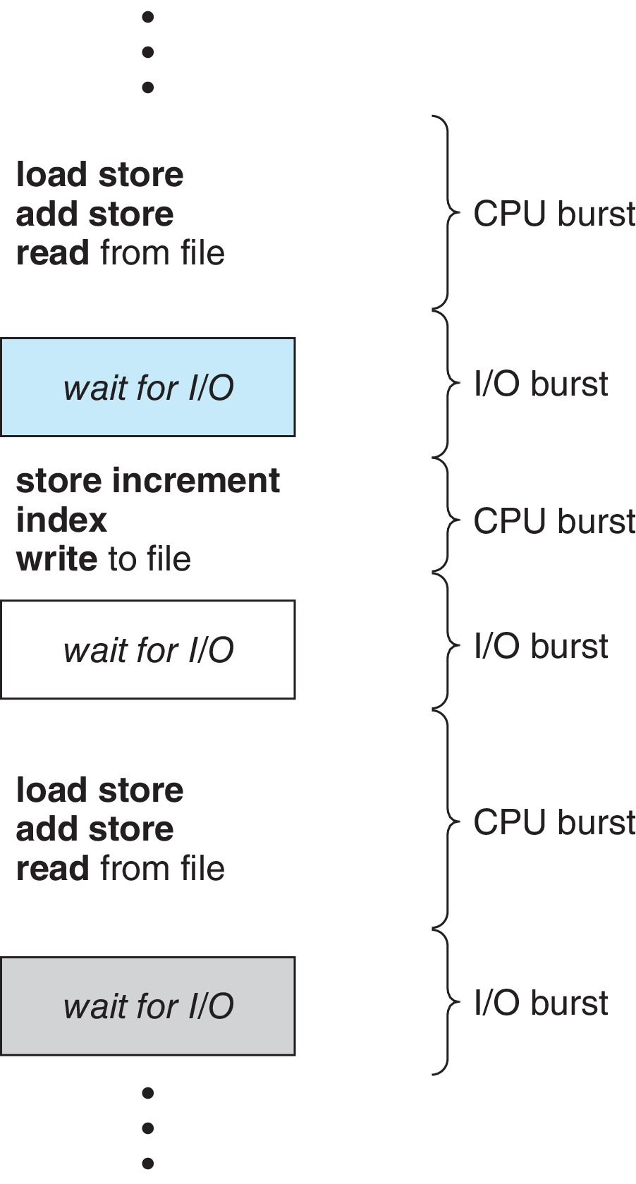
Basic Concepts
Maximum CPU utilization obtained with multiprogramming
“Burst” means:
➡️ a short period of activity
A process does two repeating states
CPU Burst
I/O Burst
CPU–I/O Burst Cycle(Two States) – Process execution consists of a cycle of CPU execution and I/O wait
CPU burst followed by I/O burst
CPU burst distribution is the main concern
Note:
CPU Burst : is when the process is being executed in the CPU
The process is actively using the CPU to execute instructions.
I/O Burst : is when the CPU is waiting for I/O for further execution
The process stops using CPU and waits for input/output operations.

Slide 7
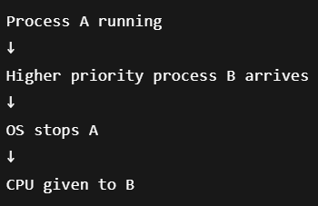
CPU Scheduler
The CPU scheduler selects from among the processes in the ready queue, and allocates a CPU core to one of them
The queue may be ordered in various ways
CPU scheduling decisions may take place when a process:
1. Switches from running to waiting state
2. Switches from running to ready state
3. Switches from waiting to ready
Terminates
Scheduling under 1 and 4 is non-preemptive
Process decides when to leave CPU.
All other scheduling is preemptive
Operating system decides when to remove process from CPU.
Situation | Meaning | Type
Running → Waiting | Process waits for I/O | Non-preemptive
Running → Ready | OS removes process from CPU | Preemptive
Waiting → Ready | I/O finished | Preemptive
Terminates | Process finished | Non-preemptive
Notes:
Simple Analogy 🎓
Imagine classroom presentation.
Non-Preemptive
Student stops speaking voluntarily:
goes to bathroom
finishes presentation
Teacher did not stop him.
Preemptive
Teacher interrupts:
“Time finished!”
“Next student!”
Teacher forcefully changes speaker.

Slide 8
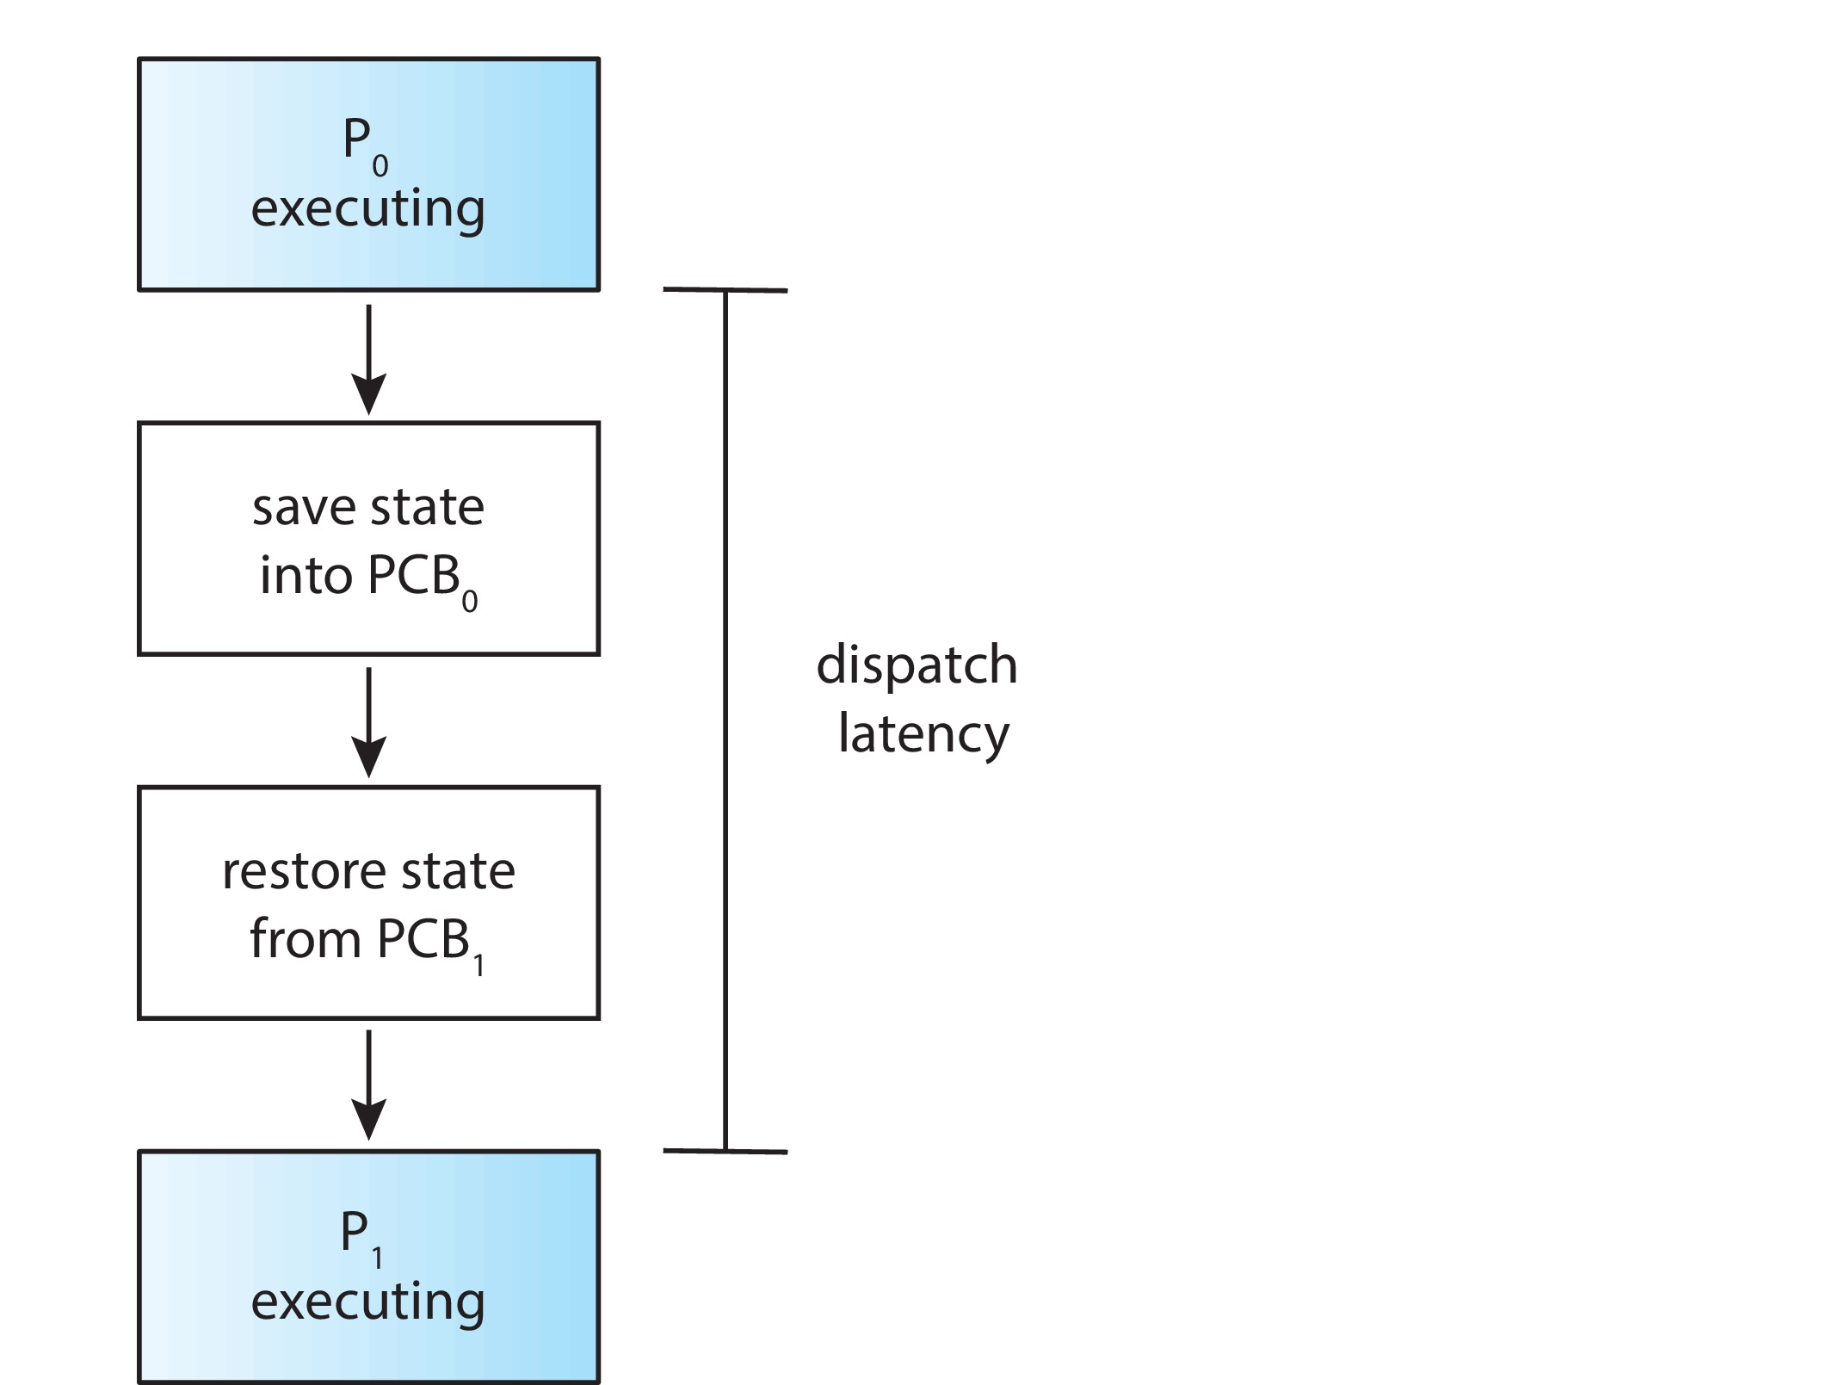
Dispatcher
Dispatcher module gives control of the CPU to the process selected by the short-term scheduler; this involves:
switching context
switching to user mode
jumping to the proper location in the user program to restart that program
Dispatch latency – time it takes for the dispatcher to stop one process and start another running

Slide 9
Scheduling Criteria
How we evaluate CPU Scheduling Algorithms
The OS wants to know:
“Which scheduling algorithm is better?”
So we measure performance using some criteria.
Many criteria have been suggested for comparing CPU-scheduling algorithms.
CPU utilization – keep the CPU as busy as possible
Teacher teaching most of the class time = good utilization.
Teacher sitting idle most time = poor utilization
Throughput – Number of processes that complete their execution per time unit
How many students finish exam per hour.
More completed students = higher throughput
Turnaround time – the amount of time to execute a particular process
Process arrives at: 2 PM
Finishes at: 2:10 PM
Turnaround time:10 minutes
Waiting time – amount of time a process has been waiting in the ready queue
How long process waits in ready queue before getting CPU.
Response time – amount of time it takes from when a request was submitted until the first response is produced, not output (for time-sharing environment)
Example Response Time = 1 second
You open browser.
click website now
first page appears after 1 second
full loading takes 5 seco
Notes:
Turnaround time includes:
waiting time
CPU execution
I/O waiting
Everything until completion.

Slide 10
Scheduling Algorithm Optimization Criteria
It is desirable to maximize CPU utilization and throughput and to minimize turnaround time, waiting time, and response time.
Maximize CPU utilization
Maximize throughput
Minimize turnaround time
Minimize waiting time
Minimize response time

Slide 11
Scheduling Algorithms
CPU scheduling deals with the problem of deciding which of the processes in the ready queue is to be allocated the CPU. There are many different CPU-scheduling algorithms.
First-Come, First-Served (FCFS)
Shortest-Job-First (SJF)
Priority
Round Robin (RR)

Slide 12
FCFS Scheduling
It assigns CPU to the process that comes first. Non-Preemptive
First come, first served (FCFS), is the simplest scheduling algorithm
FCFS simply queues processes in the order that they arrive in the ready queue.
FCFS Rules
Without Arrival Time (or all arrival times = 0) In this, the process that comes first will be executed first and next process starts only after the previous gets fully execute.
With Arrival Time :
Rule 1 : If arrival times are different ,the process with the smaller arrival time will be executed first.
Rule 2 : If two or more processes arrive at the same time, the process that enters the ready queue first will be executed first.
Advantages of FCFS
Simple and easy to implement

Slide 13
FCFS Scheduling
Disadvantages of FCFS:
The scheduling method is non preemptive, the process will run to the completion.
Due to the non-preemptive nature of the algorithm, the problem of starvation may occur.
What is Starvation? Starvation means , A process waits for very long time or forever.
Important Note
Starvation usually happens in:
Priority Scheduling
SJF (sometimes)
NOT commonly in FCFS.
Because in FCFS:
every process eventually gets CPU in queue order.
Although it is easy to implement, but it is poor in performance since the average waiting time is higher as compared to other scheduling algorithms.

Slide 14
FCFS Scheduling-traditional method Formula calculation

Slide 15
FCFS Scheduling-traditional method
Without Arrival Time (or all arrival times = 0)
Input the processes along with their burst time (bt).
Find waiting time (wt) for all processes.
First process need not to wait so waiting time for first process will be 0.
Waiting time for each other processes i.e. for process i:
wt[i] = bt[i-1] + wt[i-1] or
wt = tt – bt
previous burst time + previous waiting time
Turnaround time (tt) for each processes:
Turnaround time = bt + wt
Average waiting time =
total_waiting_time / no_of_processes
Similarly, average turnaround time =
total_turn_around_time / no_of_processes

Slide 16
FCFS Scheduling-traditional method
With Arrival Time :
Input the processes along with their burst time (bt).
Find waiting time (wt) for all processes.
Sorted by using with arrival time first process is lowest process of arrival time is the first
Waiting time for each other processes i.e. for process i:
If arrival time (at) provided, then:
wt = starting time (st) – at
If arrival time (at) provided, then:
Turnaround time = completion time (ct) - at
Average waiting time =
total_waiting_time / no_of_processes
Similarly, average turnaround time =
total_turn_around_time / no_of_processes

Slide 17
Example of traditional method calculation Without Arrival Time (or all arrival times = 0)

Slide 18
Without Arrival Time (or all arrival times = 0)
Process Burst Time
P₁ 24
P₂ 3
P₃ 3
Suppose that the processes arrive in the order: P₁ , P₂ , P₃ The Gantt Chart for the schedule is:
Waiting time
P1 is first →
wt[0] = 0 (first process never waits)
P2 →
wt[1] = bt[0] + wt[0] = 24+0=24
P3 →
wt[2] = bt[1] + wt[1] = 3+24=27
P₁
P₂
P₃
0
24
27
30

Slide 19
Without Arrival Time (or all arrival times = 0)
Turnaround time for Turnaround time = bt + wt
P₁ = 24+0 = 24, P₂ = 3+24 = 27, P₃ = 3+27 = 30
Average waiting time:
total_waiting_time / no_of_processes
(0 + 24 + 27) / 3 = 51/3 = 17 ms.
Average turnaround time
total_waiting_time / no_of_processes
= (24+27+30)/3 = 81/3 = 27 ms

Slide 20
Example of traditional method calculation With Arrival Time(Two Process is equal)

Slide 21
With Arrival Time(Two Process is equal)
Process Arrival Time Burst Time
P₁ 2 24
P₂ 2 3
P₃ 1 3
Step 1 — Sort by Arrival Time Smallest arrival time executes first.
P3 arrives first (AT = 1)
P1 and P2 both arrive at time 2
Assume : P1 entered queue before P2
Execution order P3 → P1 → P2 Step 2 — Draw Gantt Chart
Process | Arrival Time | Burst Time
P2 | 1 | 3
P1 | 2 | 24
P2 | 2 | 3
0--1 |Idle|
P₃
P₁
P₂
1
4
28
31
Step 3 — Find Starting Time (ST)
Process | ST
P3 | 1
P1 | 4
P2 | 28

Slide 22
Step 4 — Find Completion Time (CT)
Step 5 — Find Waiting Time (WT) Formula: WT = ST − AT
P2 : WT = 1 − 1 = 0
P1 : WT = 4 − 2 = 2
P3 : WT = 28 − 2 = 26
Waiting Time Table
Process | CT
P3 | 4
P1 | 28
P2 | 31
Process | WT
P2 | 0
P1 | 2
P3 | 26

Slide 23
Step 6 — Find Turnaround Time (TT) Formula: TT = CT − AT
P2 : TT = 4 − 1 = 3
P1 : TT = 28 − 2 = 26
P3 : TT = 31 − 2 = 29
Turnaround Time Table
Step 7 — Average Waiting Time
(0 + 2 + 26) / 3 = 28 / 3 = 9.33
Step 8 — Average Turnaround Time
(3 + 26 + 29) / 3 = 58 / 3 = 19.33
Final Answer
Process | TT
P2 | 3
P1 | 26
P3 | 29
Process | AT | BT | ST | CT | WT | TT
P3 | 1 | 3 | 1 | 4 | 0 | 3
P1 | 2 | 24 | 4 | 28 | 2 | 26
P2 | 2 | 3 | 28 | 31 | 26 | 29

Slide 24
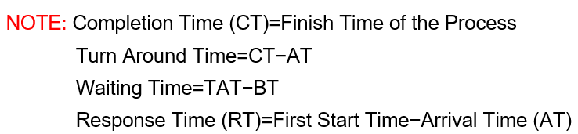
Example of Modern method calculation With Arrival Time(Two Process is equal)

Slide 25
Process | Arrival Time | Burst Time | Completion Time | Turnaround Time | Waiting Time | Response Time
Process 1 | 0 | 24 | ? | ? | ? | ?
Process 2 | 0 | 3 | ? | ? | ? | ?
Process 3 | 0 | 3 | ? | ? | ? | ?
Step 1 — Draw Gantt Chart
P₁
P₂
P₃
0
24
27
30
Step 2 — Completion Time (CT)
Process | Arrival Time | Burst Time | Completion Time | Turnaround Time | Waiting Time | Response Time
Process 1 | 0 | 24 | 24 | ? | ? | ?
Process 2 | 0 | 3 | 27 | ? | ? | ?
Process 3 | 0 | 3 | 30 | ? | ? | ?
Step 3 — Turnaround Time (TAT) Formula TAT = CT − AT
P1 :24 − 0 = 24
P2 :27 − 0 = 27
P3 :30 − 0 = 30
Process | Arrival Time | Burst Time | Completion Time | Turnaround Time | Waiting Time | Response Time
Process 1 | 0 | 24 | 24 | 24 | ? | ?
Process 2 | 0 | 3 | 27 | 27 | ? | ?
Process 3 | 0 | 3 | 30 | 30 | ? | ?

Slide 26
Step 4 — Waiting Time (WT) Formula: WT = TAT − BT
P1 :24 − 24 = 0
P2 :27 − 3 = 24
P3 :30 − 3 = 27
Process | Arrival Time | Burst Time | Completion Time | Turnaround Time | Waiting Time | Response Time
Process 1 | 0 | 24 | 24 | 24 | 0 | ?
Process 2 | 0 | 3 | 27 | 27 | 24 | ?
Process 3 | 0 | 3 | 30 | 30 | 27 | ?
Step 5 — Response Time (RT) Formula RT = First Start Time − AT
Process | Arrival Time | Burst Time | Completion Time | Turnaround Time | Waiting Time | Response Time
Process 1 | 0 | 24 | 24 | 24 | 0 | 0
Process 2 | 0 | 3 | 27 | 27 | 24 | 24
Process 3 | 0 | 3 | 30 | 30 | 27 | 27
Step 6 — Average Waiting Time
(0 + 24 + 27) / 51 = 51 / 3 = 17Ms
Step 7 — Average Turnaround Time
(24 + 27 + 30) / 3 = 81 / 3 = 27ms

Slide 27
Example of Modern method calculation With Arrival Time(Two Process is equal) of Modern method calculation Without Arrival Time (or all arrival times = 0)

Slide 28
Process | Arrival Time | Burst Time | Completion Time | Turnaround Time | Waiting Time | Response Time
Process 1 | 2 | 24 | ? | ? | ? | ?
Process 2 | 2 | 3 | ? | ? | ? | ?
Process 3 | 1 | 3 | ? | ? | ? | ?
Step 1 — Sort by Arrival Time Smallest arrival time executes first
P3 arrives first
P1 and P2 both have: AT = 2
Assume P1 entered ready queue before P2.
Process | Arrival Time | Burst Time | Completion Time | Turnaround Time | Waiting Time | Response Time
Process 3 | 1 | 3 | ? | ? | ? | ?
Process 1 | 2 | 24 | ? | ? | ? | ?
Process 2 | 2 | 3 | ? | ? | ? | ?
Step 2 — Draw Gantt Chart Formula TAT = CT − AT
P₃
P₂
P₃
1
4
28
31

Slide 29
Process | Arrival Time | Burst Time | Completion Time | Turnaround Time | Waiting Time | Response Time
Process 3 | 1 | 3 | ? | ? | ? | ?
Process 1 | 2 | 24 | ? | ? | ? | ?
Process 2 | 2 | 3 | ? | ? | ? | ?
Step 3 — Completion Time (CT)
Process | Arrival Time | Burst Time | Completion Time | Turnaround Time | Waiting Time | Response Time
Process 3 | 1 | 3 | 4 | ? | ? | ?
Process 1 | 2 | 24 | 28 | ? | ? | ?
Process 2 | 2 | 3 | 31 | ? | ? | ?
Step 4 — Turnaround Time (TAT) Formula TAT = CT − AT
P3 :4 − 1 = 3
P1 :28 − 2 = 26
P2 :31 − 2 = 29
Process | Arrival Time | Burst Time | Completion Time | Turnaround Time | Waiting Time | Response Time
Process 3 | 1 | 3 | 4 | 3 | ? | ?
Process 1 | 2 | 24 | 28 | 26 | ? | ?
Process 2 | 2 | 3 | 31 | 29 | ? | ?

Slide 30
Process | Arrival Time | Burst Time | Completion Time | Turnaround Time | Waiting Time | Response Time
Process 3 | 1 | 3 | 4 | 3 | ? | ?
Process 1 | 2 | 24 | 28 | 26 | ? | ?
Process 2 | 2 | 3 | 31 | 29 | ? | ?
Step 5 — Waiting Time (WT) Formula WT = TAT − BT
P3 :3 − 3 = 0
P1 :26 − 24 = 2
P2 :29 − 3 = 26
Process | Arrival Time | Burst Time | Completion Time | Turnaround Time | Waiting Time | Response Time
Process 3 | 1 | 3 | 4 | 3 | 0 | ?
Process 1 | 2 | 24 | 28 | 26 | 2 | ?
Process 2 | 2 | 3 | 31 | 29 | 26 | ?
Step 6 — Response Time (RT) RT = First Start Time − AT
Start Times:
P3 starts at 1
P1 starts at 4
P2 starts at 28
P3: 1 − 1 = 0
P1 :4 − 2 = 2
P2: 28 − 2 = 26
Process | Arrival Time | Burst Time | Completion Time | Turnaround Time | Waiting Time | Response Time
Process 3 | 1 | 3 | 4 | 3 | 0 | 0
Process 1 | 2 | 24 | 28 | 26 | 2 | 2
Process 2 | 2 | 3 | 31 | 29 | 26 | 26

Slide 31
Process | Arrival Time | Burst Time | Completion Time | Turnaround Time | Waiting Time | Response Time
Process 3 | 1 | 3 | 4 | 3 | 0 | 0
Process 1 | 2 | 24 | 28 | 26 | 2 | 2
Process 2 | 2 | 3 | 31 | 29 | 26 | 26
Step 7 — Average Waiting Time
(0 + 2 + 26) / 30 = 30 / 3 = 10Ms
Step 8 — Average Turnaround Time
(3 + 26 + 29) / 3 = 58 / 3 = 19.33ms

Slide 32
End of Chapter 5

